Slide 1
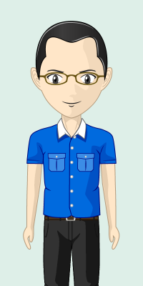
Works in an office.
Does most of his work on his laptop which he brings home everyday.
Describes himself as a “keyboarder”.
John

Slide 2

John’s First Day at Work…

Slide 3
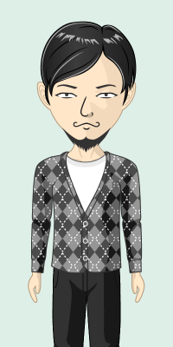
Boss: Can you go through these documents and give me a report by evening?
John: Yes boss!
John
Boss

Slide 4
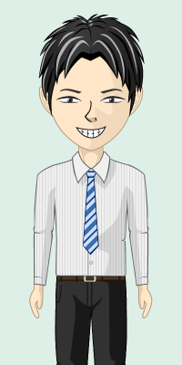
Manager: Bring 20 cups of coffee to the meeting later!
John: Yes, will do!
John
Manager

Slide 5
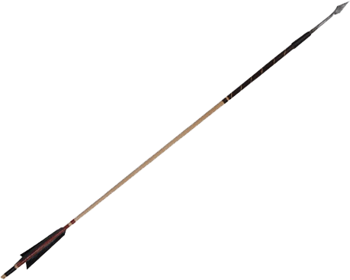


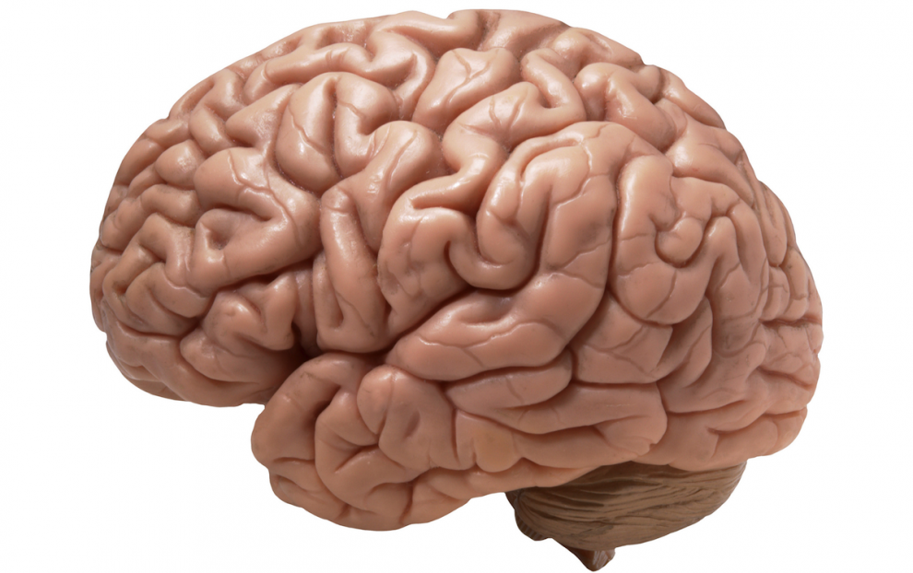




John’s Brain

Slide 6
Later in the evening…

Slide 7


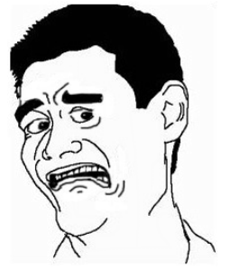

John’s Brain

Slide 8
The following day…

Slide 9

John

Slide 10
Boss: You did a great job! Someone like you should do 5 reports per day!
John: Yes boss!
John
Boss

Slide 11

5 Reports Today
For boss
New Buddy’s
Report
30 Cups of Coffee
for meeting later
Buy more coffee
powder

Slide 12
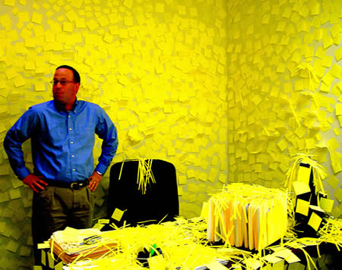
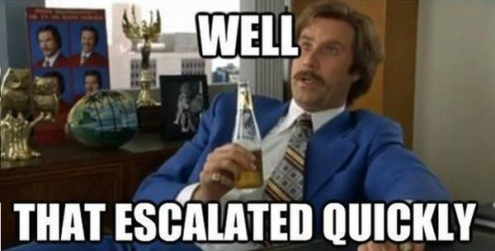

Slide 13
Yet another day later…

Slide 14
John

Slide 15
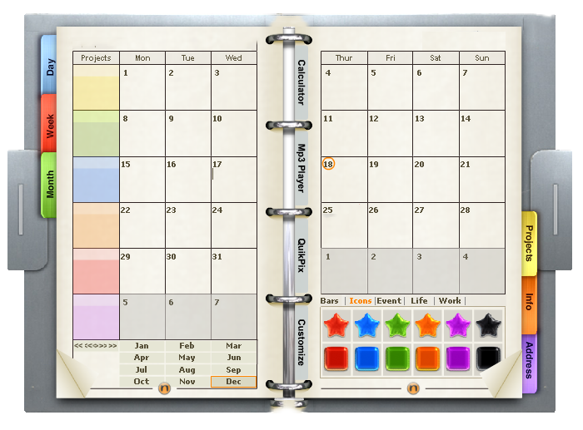
Borrow
borrow
10 reports today
Walk boss’s cat
Friend’s report
50 cups of coffee
some tiny task that I can’t read
Borrow some space here

Slide 16


Borrow
borrow
10 reports today
Walk boss’s cat
Friend’s report
50 cups of coffee
some tiny taskthat I can’t read
Borrow some space here

Slide 17
…

Slide 18
John

Slide 19
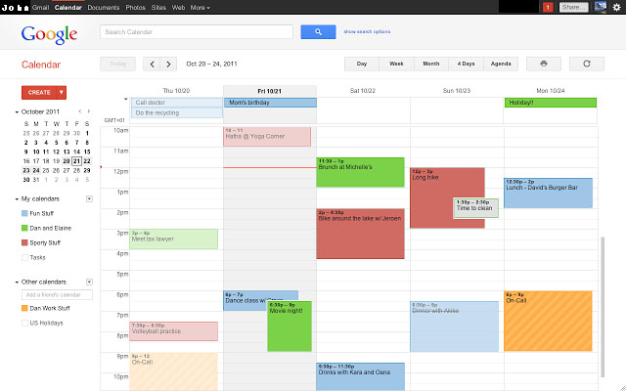
Everything’s going so smoothly today!

Slide 20
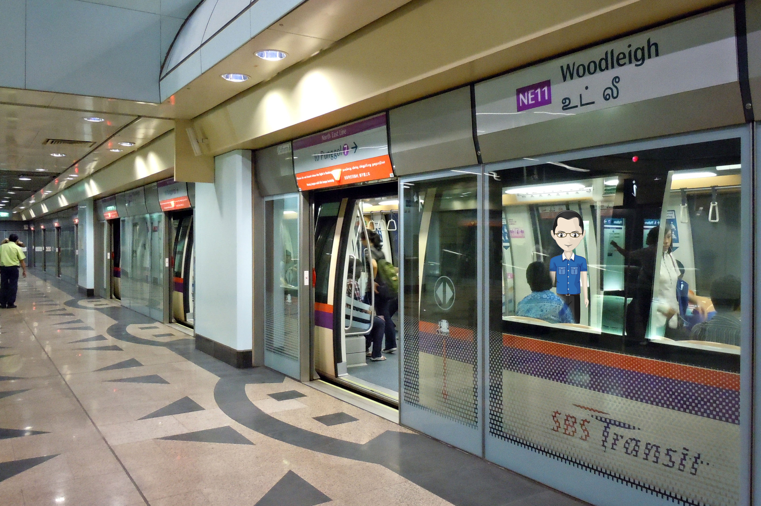

Slide 21
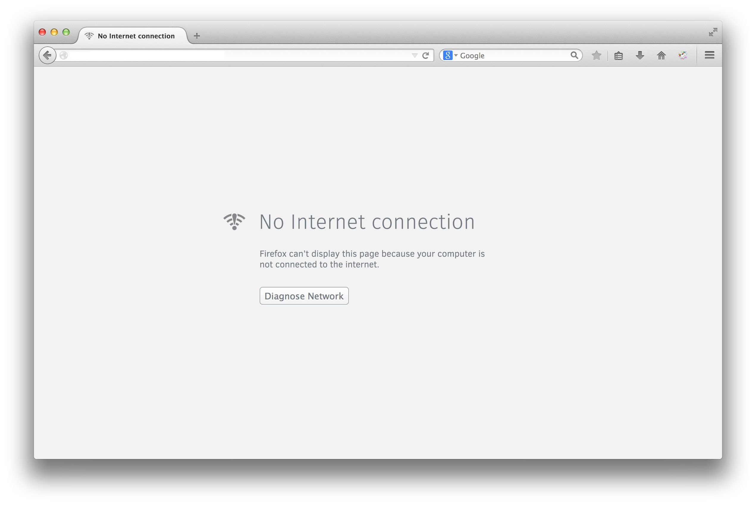

Slide 22
Have a busy schedule?
Type faster than you can write?
Need to manage your tasks centrally?
Don’t want to use the mouse so much?
Want to manage your schedule without an Internet connection?
YES!

Slide 23
Picture of UI over here
Task Catalyst

Slide 24


Task Catalyst

Slide 25


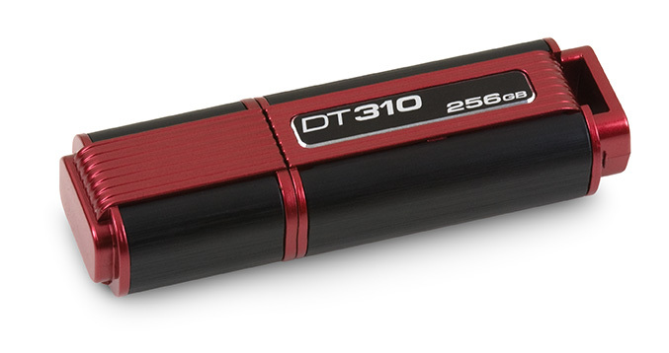
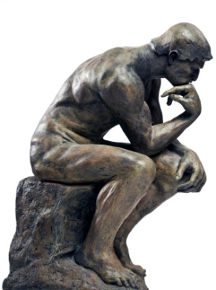
Vision
What am I doing next??

Slide 26
What Tast Catalyst Can Do
C
R
U
D
reate
ead
pdate
elete

Slide 27

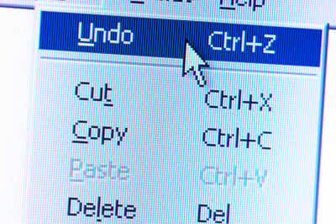

What Task Catalyst Can Do

Slide 28
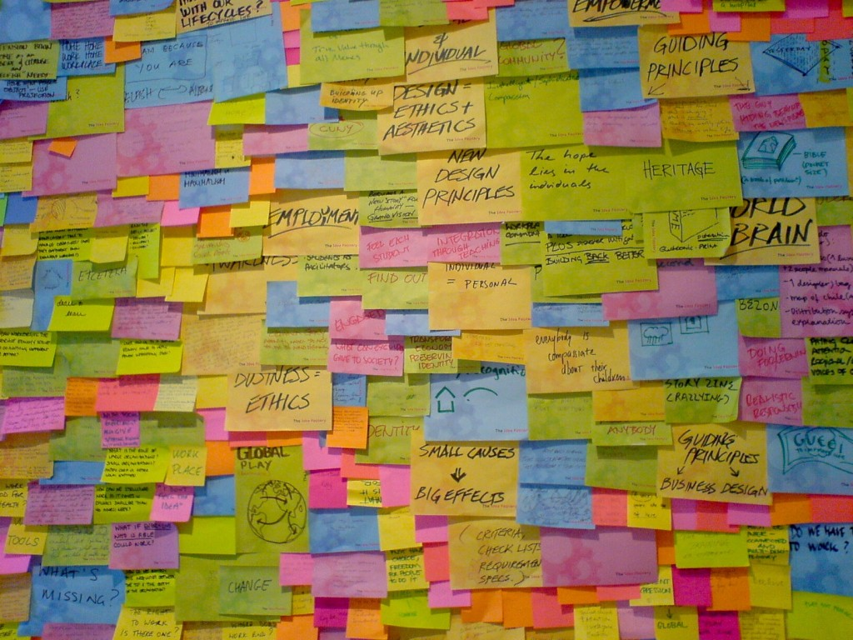


What Task Catalyst Can Do

Slide 29

What Task Catalyst Can Do
Physics Online Assignment 1
CS2101 Reflection

